Slide 1
Azure Machine Learning Services
and Azure Machine Learning Workbench

Slide 2
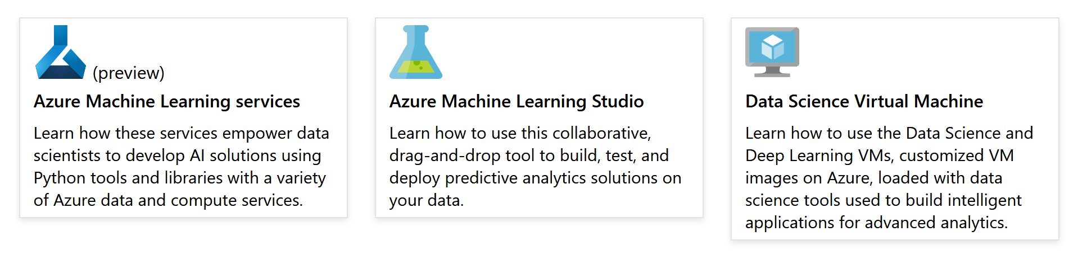
Azure Machine Learning Documentation
https://docs.microsoft.com/en-us/azure/machine-learning/

Slide 3
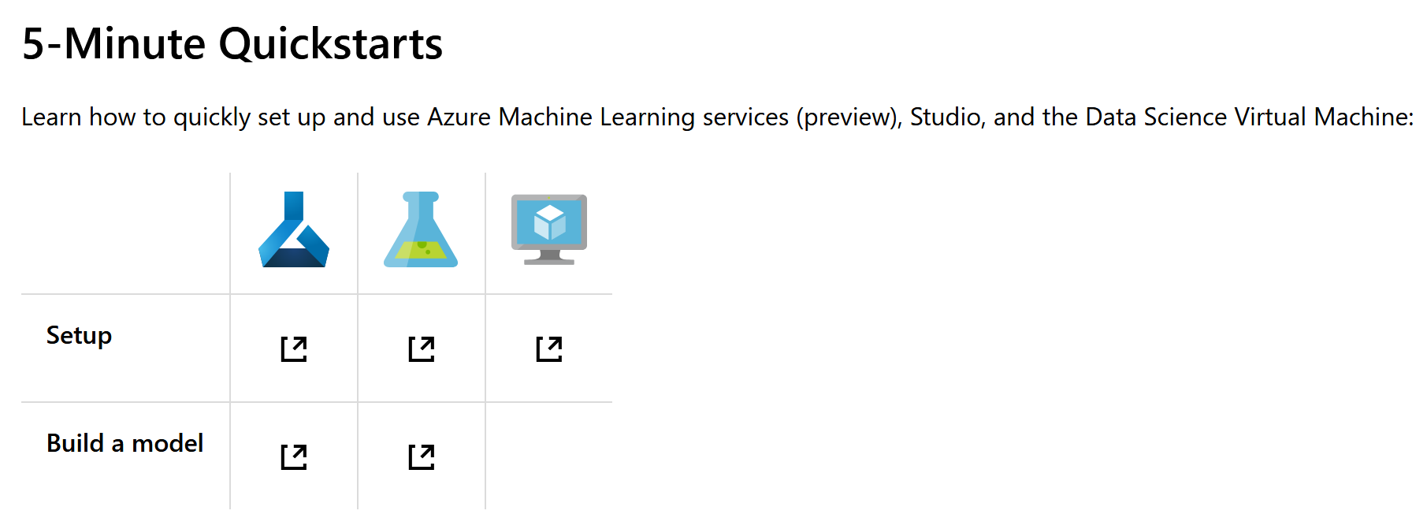
Azure Machine Learning Documentation
https://docs.microsoft.com/en-us/azure/machine-learning/

Slide 4
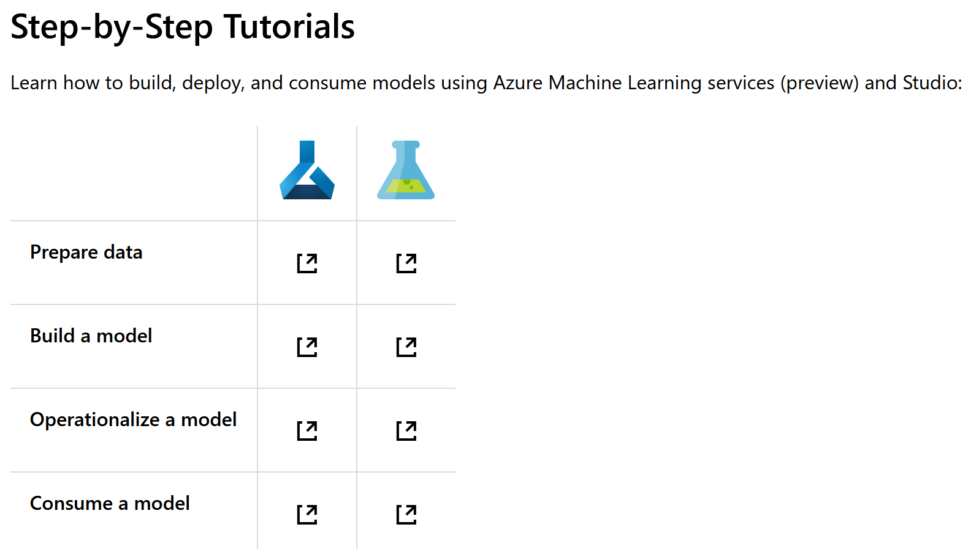
Azure Machine Learning Documentation
https://docs.microsoft.com/en-us/azure/machine-learning/

Slide 5
Azure Machine Learning Workbench
Azure ML Workbench supports the following activities
Azure Machine Learning
Data Preparation
Experimentation
Model Management
Azure Machine Learning Services are separated into:
Azure Machine Learning Experimentation Service
Azure Machine Learning Model Management Service

Slide 6
Machine Learning (in general)
…is a data science technique
…allows computers to use existing data to forecast future behaviors, outcomes, and trends.
Computers learn without being explicitly programmed.
Predictions can make apps and devices smarter.
Online Shopping: ML helps recommend products you might like… based on what you've purchased.

Slide 7
Azure Machine Learning
…is an integrated, end-to-end data science and advanced analytics solution.
…enables data scientists to prepare data, develop experiments, and deploy models at cloud scale.
Main components of Azure Machine Learning:
Azure Machine Learning Workbench
Azure Machine Learning Experimentation Service
Azure Machine Learning Model Management Service
Microsoft Machine Learning Libraries for Apache Spark (MMLSpark Library)
Visual Studio Code Tools for AI

Slide 8
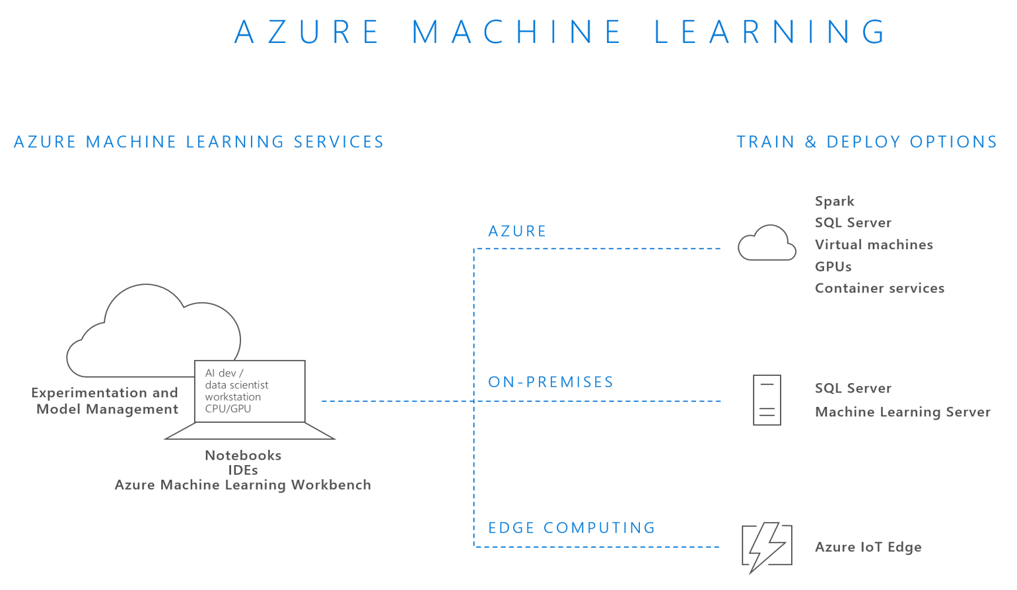
Azure Machine Learning

Slide 9
Azure Machine Learning
fully supports open source technologies, such as:
scikit-learn
TensorFlow
Microsoft Cognitive Toolkit
Spark ML
is built on top of the following open source technologies:
Jupyter Notebook
Apache Spark
Docker
Kubernetes
Python

Slide 10
Azure Machine Learning Workbench
…is a desktop application plus command-line tools.
…allows you to manage machine learning solutions through the entire data science life cycle:
Data ingestion and preparation
Model development and experiment management
Model deployment in various target environments

Slide 11
Azure Machine Learning Workbench 1/2
core functionalities :
Data preparation tool that can learn data transformation logic by example.
Data source abstraction accessible through UI Python code.
Python SDK for invoking visually constructed data preparation packages.
Built-in Jupyter Notebook service and client ui.

Slide 12
Azure Machine Learning Workbench 2/2
further core functionalities
Experiment monitoring and management through run history views.
Role-based access control that enables sharing and collaboration through Azure Active Directory.
Automatic project snapshots for each run, and explicit version control enabled by native Git integration.
Integration with popular Python IDEs.

Slide 13
Azure Machine Learning Experimentation Service
…handles the execution of machine learning experiments.
…supports the Workbench by providing project management, Git integration, access control, roaming, and sharing.
execute your experiments across a range of compute environment options:
Local native
Local Docker container
Docker container on a remote VM
Scale out Spark cluster in Azure

Slide 14
Azure Machine Learning Experimentation Service
…constructs virtual environments to ensure that your script can be executed in isolation with reproducible results.
…records run history information and presents the history to you visually. You can easily select the best model out of your experiment runs.
https://docs.microsoft.com/de-de/azure/machine-learning/desktop-workbench/experimentation-service-configuration

Slide 15
Azure Machine Learning Model Management Service
allows data scientists and dev-ops teams to deploy predictive models into a wide variety of environments.
Model versions and lineage are tracked from training runs to deployments.
Models are stored, registered, and managed in the cloud.
Using simple CLI commands, you can containerize your model, scoring scripts and dependencies into Docker images. These images are registered in your own Docker registry hosted in Azure (Azure Container Registry).

Slide 16
Azure Machine Learning Model Management Service
Containerized models can be reliably deployed to the following targets:
Local machines
On-premises servers
The cloud
IoT edge devices
Kubernetes running in the Azure Container Service (ACS) is used for cloud scale-out deployment.
Model execution telemetry is captured in AppInsights for visual analysis.
https://docs.microsoft.com/de-de/azure/machine-learning/desktop-workbench/model-management-overview

Slide 17
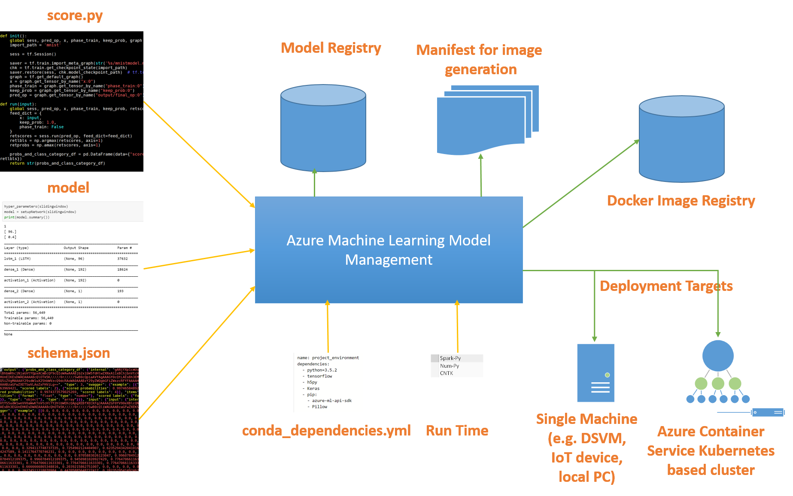
AML Model Management (Overview)

Slide 18

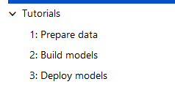
Quick-Start
Install and get started with Azure Machine Learning services
https://docs.microsoft.com/en-us/azure/machine-learning/service/quickstart-installation

Slide 19
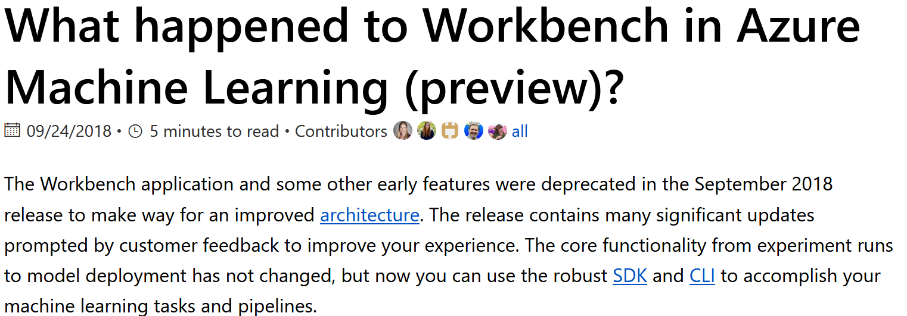
What happened to Workbench?
https://docs.microsoft.com/en-us/azure/machine-learning/service/overview-what-happened-to-workbench

Slide 20
How to migrate
https://docs.microsoft.com/en-us/azure/machine-learning/service/how-to-migrate
Most artifacts created in the first preview of Azure Machine Learning service are stored in your own local or cloud storage.
These artifacts won't disappear.
To migrate, register the artifacts again with the updated Azure Machine Learning service.

